Slide 1
Parameter Estimation:
Maximum Likelihood Estimation
Chapter 3 (Duda et al.) – Sections 3.1-3.2
CS479/679 Pattern Recognition
Dr. George Bebis

Slide 2
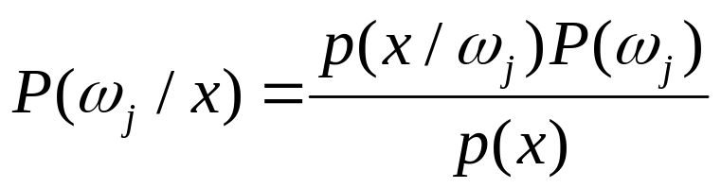
Parameter Estimation
    Bayesian Decision Theory allows us to design an optimal classifier using the Bayes rule:
Estimating P(ω_{i}) is usually not very difficult.
Estimating p(x/ω_{i}) could be challenging:
  Dimensionality of feature space is large.
  Number of samples is often too small.

Slide 3
Parameter Estimation (cont’d)
Assumptions
  A set of training samples D ={x₁, x₂, ...., x_{n}} is provided where the samples were drawn according to p(x|ω_{j}).
  p(x|ω_{j}) has some known parametric form:
Parameter estimation problem
e.g., p(x /ω_{j}) ~ N(μ, Σ)
also denoted as p(x/ω_{j} ,θ) or p(x/θ) where θ=(μ, Σ)
  Given D, find the best possible θ

Slide 4

Problem Formulation
Consider c classes and c training data sets (i.e., one for each class):
Given D₁, D₂, ...,D_{c} and a model p(x/ω_{j}) ~ p(x/θ_{j}), for each class ω_{j} , j=1,2,…,c, estimate:
If the samples in D_{j} provide no information about θ_{i} ( ), we need to solve c independent problems (i.e., one for each class).
  D₁, D₂, ...,D_{c}
θ₁, θ₂,…, θ_{c}

Slide 5

Main Methods
Maximum Likelihood (ML)
  Views the parameters θ as quantities whose values are fixed but unknown.
  Estimates by maximizing the likelihood of obtaining the samples observed.
Bayesian Estimation (BE)
  Views the parameters θ as random variables having some known prior distribution p(θ).
  Observing new samples D, converts the prior p(θ) to a posterior density p(θ/ D) (i.e., the samples D revise our estimate of the distribution over the parameters).

Slide 6
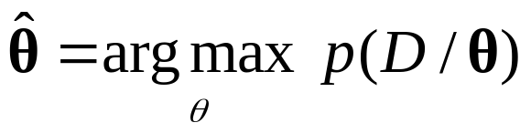
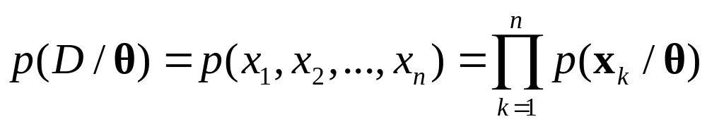
ML Estimation - Solution
  The ML estimate for D={x₁,x₂,..,x_{n}} is the value that maximizes the likelihood p(D/θ):
  This corresponds to the intuitive idea of choosing the value of 𝜃 that is most likely to give rise to the data.
  Assuming that samples in D are drawn independently according to p(x/ω_{j}):

Slide 7
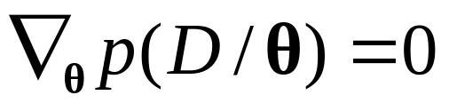
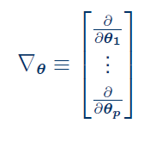
ML Estimation - Solution (cont’d)
  How can we find the maximum of p(D/ θ) ?
where
(gradient)

Slide 8
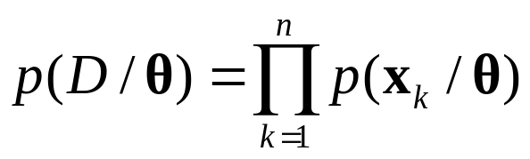
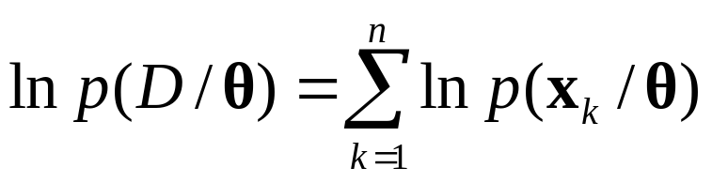
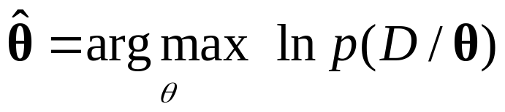
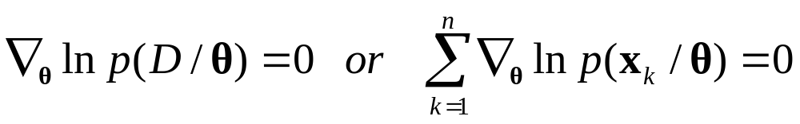
ML Estimation Using Log-Likelihood
First, take the log for simplicity:
  Need to maximize ln p(D/ θ):
log-likelihood

Slide 9
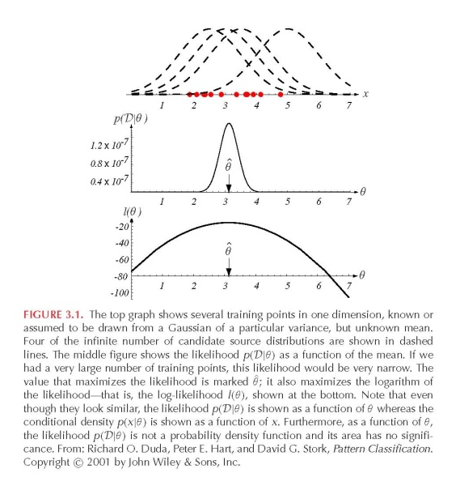
Example
red dots (training data)
Assume unknown mean,
known variance
θ=μ

Slide 10

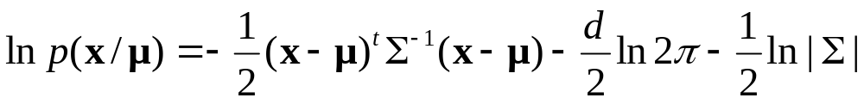
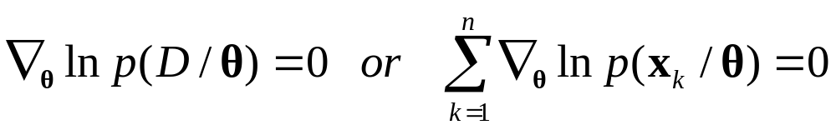

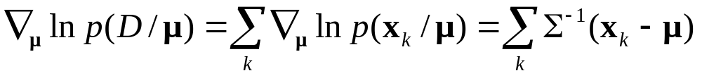
ML for Multivariate Gaussian Density:
Case of Unknown θ=μ
Assume
Compute the gradient
=

Slide 11
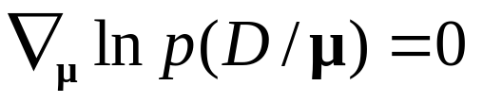
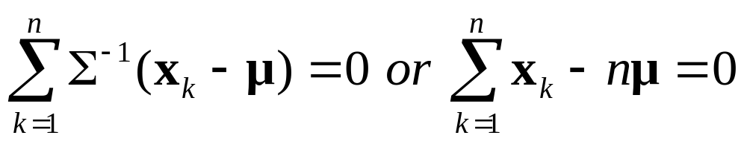
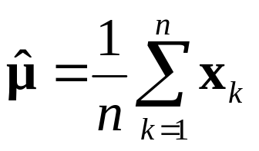

ML for Multivariate Gaussian Density:
Case of Unknown θ=μ (cont’d)
  Set :
  The solution is given by
  The ML estimate is simply the “sample mean”.

Slide 12
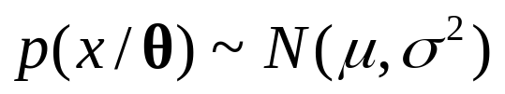
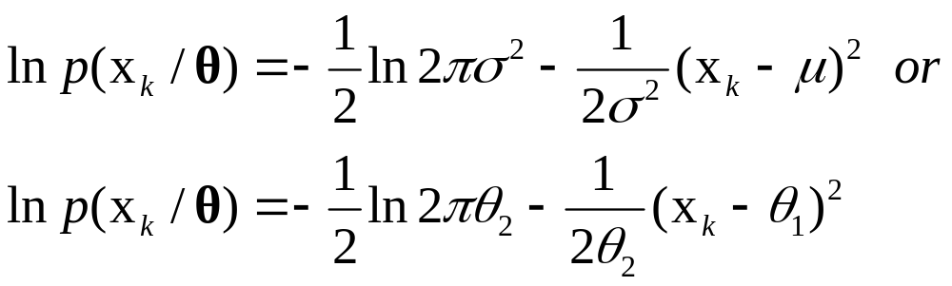
ML for Univariate Gaussian Density:
Case of Unknown θ=(μ,σ²)
  Assume
  Compute the gradient
θ =(θ₁,θ₂)=(μ,σ²)
=

Slide 13

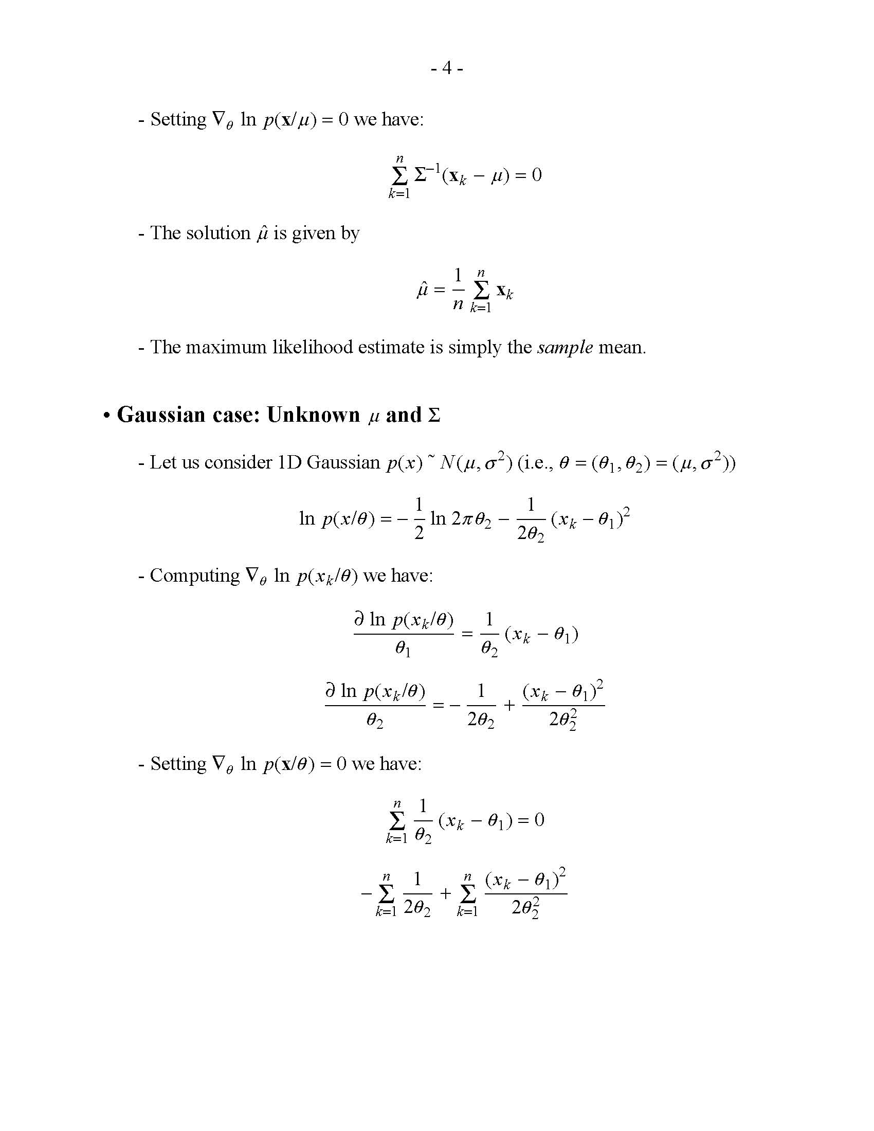
ML for Univariate Gaussian Density:
Case of Unknown θ=(μ,σ²) (cont’d)
p(x_{k}/θ)
p(x_{k}/θ)
p(x_{k}/θ)

Slide 14
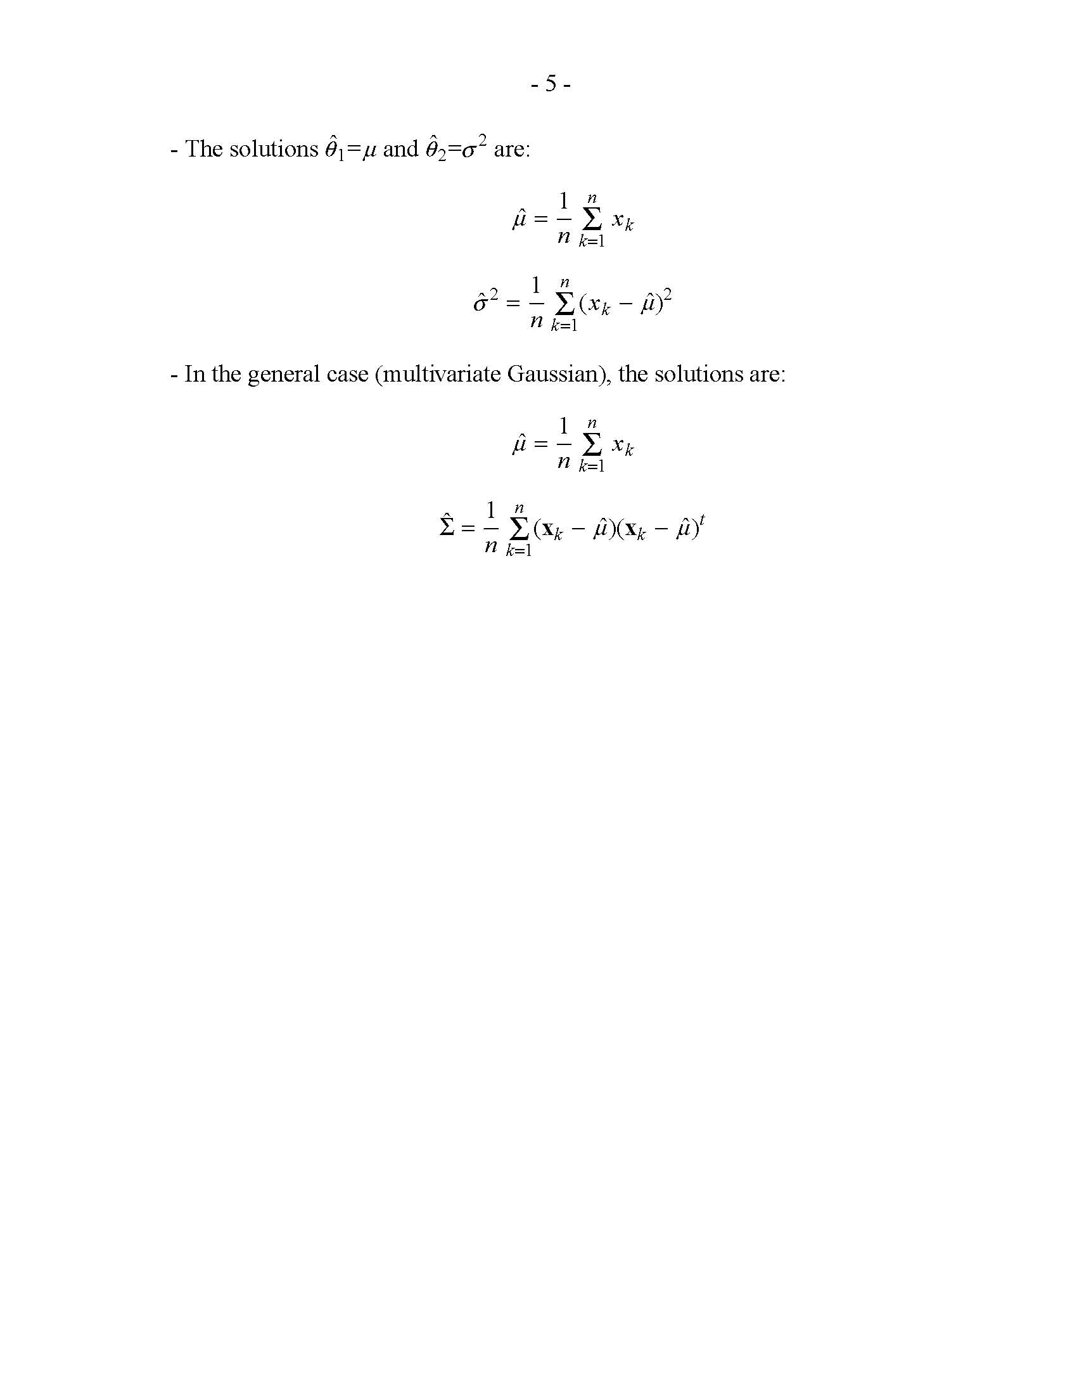
ML for Univariate Gaussian Density:
Case of Unknown θ=(μ,σ²) (cont’d)
  Set
=0
=0
=0
The solutions are given by:
sample mean
sample variance

Slide 15
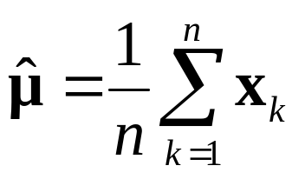
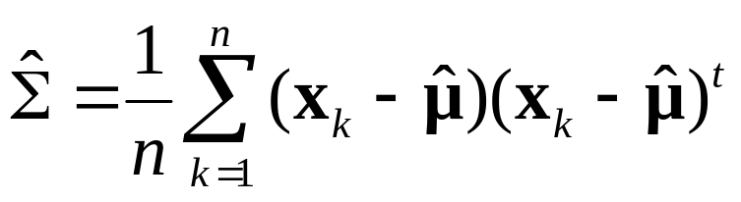
ML for Multivariate Gaussian Density:
Case of Unknown θ=(μ,Σ)
  In the general case (i.e., multivariate Gaussian) the solutions are:
sample mean
sample covariance

Slide 16
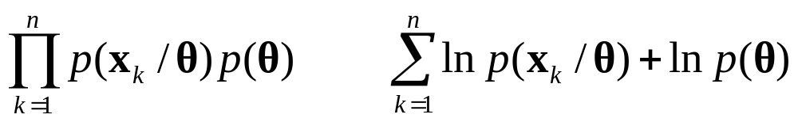
Generalize ML Estimation:
Maximum A-Posteriori Estimator (MAP)
Sometimes, we have some knowledge about θ.
Assume that θ follows some distribution p(θ).
MAP maximizes p(D/θ)p(θ) or ln [p(D/ θ)p(θ)]:

Slide 17
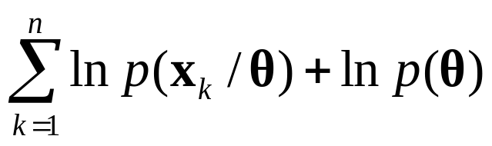
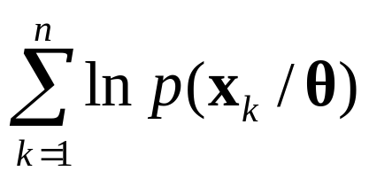
Maximum A-Posteriori Estimator (MAP) (cont’d)
  What happens when p(θ) is uniform?
MAP becomes equivalent to ML
(i.e., ML is a special case of MAP!)

Slide 18
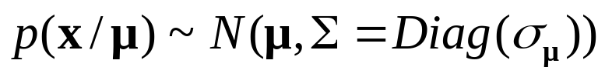
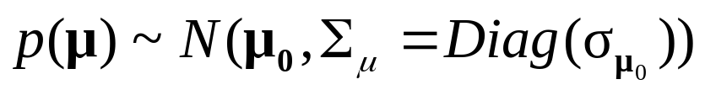

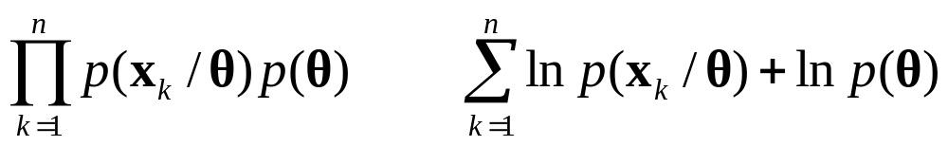
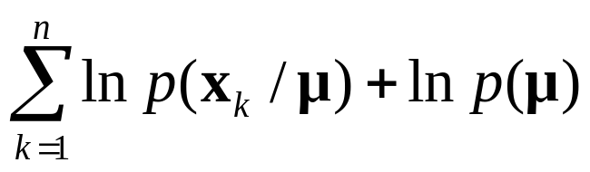
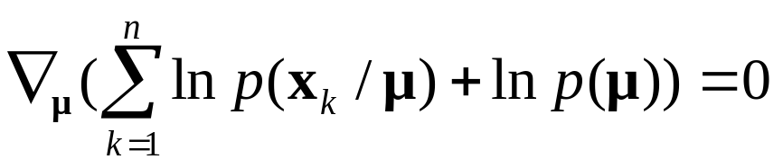
MAP for Multivariate Gaussian Density:
Case of Unknown θ=μ
  Assume
  Compute ln [p(D/ μ)p(μ)]:
  Maximize ln [p(D/ μ)p(μ)]:
and
(both are known)

Slide 19
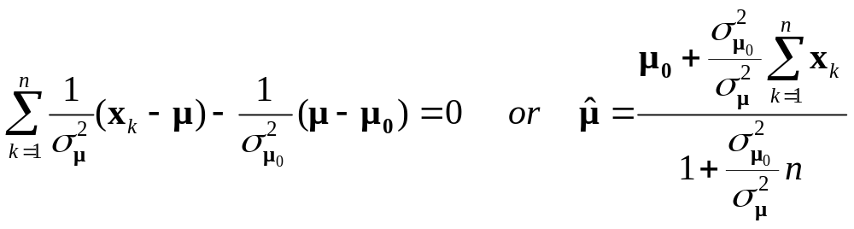
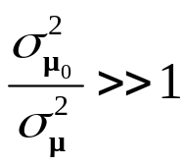

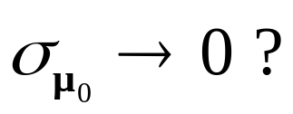

MAP for Multivariate Gaussian Density:
Case of Unknown θ=μ (cont’d)
  If , then
  What happens when

Slide 20
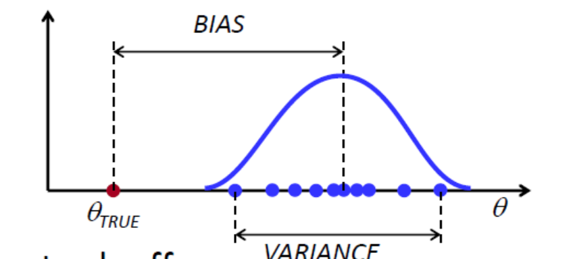
Bias and Variance
How good are the ML estimates?
  Two measures of “goodness” are used for statistical estimates
  Bias: how close is the estimate to the true value?
  Variance: how much does it change for different datasets?

Slide 21
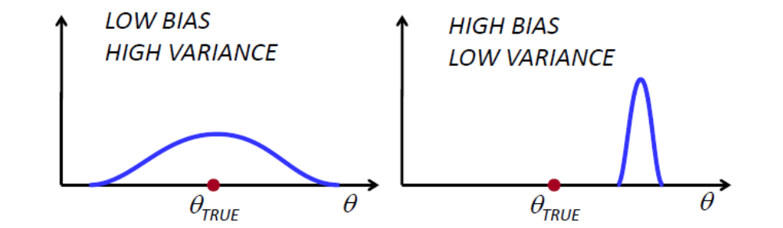
Bias and Variance
The bias-variance tradeoff: in most cases, you can only decrease one of them at the expense of the other

Slide 22
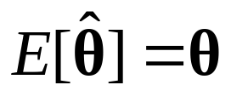

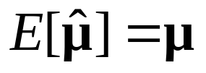


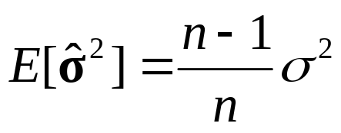
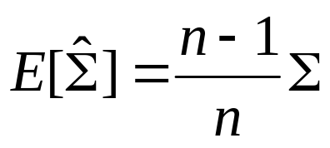
Biased and Unbiased Estimates
  An estimate is unbiased when
  The ML estimate is unbiased, i.e.,
  The ML estimates and are biased:

Slide 23
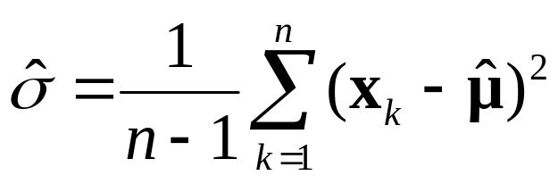
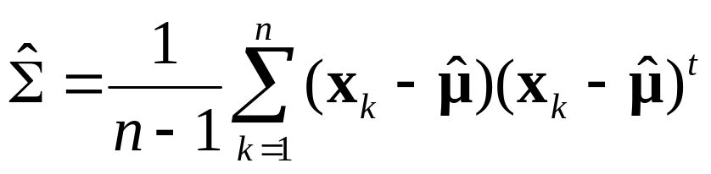
Biased and Unbiased Estimates (cont’d)
  How bad is this bias?
    - The bias is only noticeable when n is small.
  The following are unbiased estimates of and

Slide 24
Comments
  ML estimation is simpler than alternative methods.
  ML provides more accurate estimates as the number of training samples increases.
  If the assumptions about the model p(x/ θ) and independence of the samples are true, then ML works well.

